Slide 1
Parts Crib Database Project
Presentation by: Mohand Ferawana

Slide 2
Project Proposal
Parts Crib Database Project is trying to do quick and efficient way rent items from the parts crib. Where we’re trying to build and utilize a database from student cards and parts crib department inventory.
The project will use three different database reader
USB barcode scanner
Magnetic Stripe Card Swipe Reader
Barcode reader/scanner with CCD camera

Slide 3
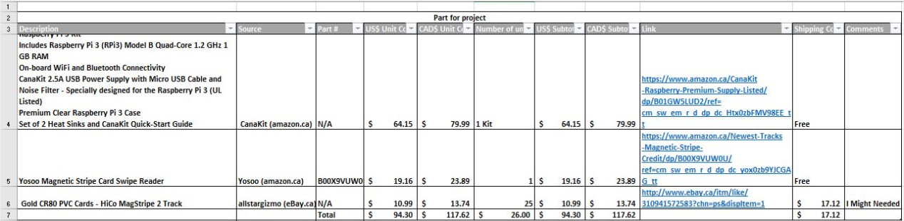
Project Budget

Slide 4
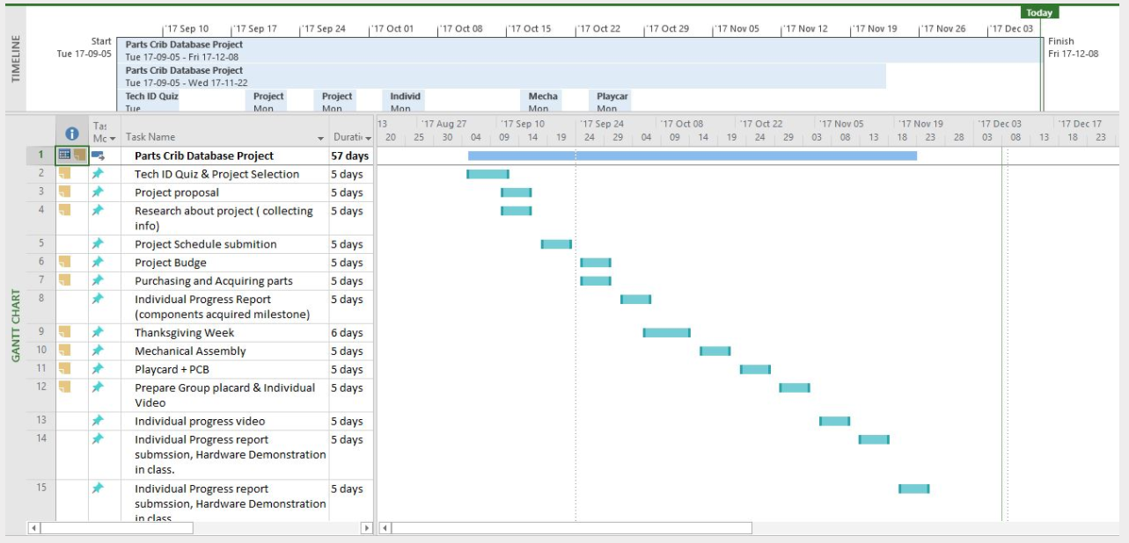
Project Schedule

Slide 5

Build Video

Slide 6
Course Knowledge
TECH 101 -Electric Circuits
TECH 104 -Programming Fundamentals
TECH 150 -Electronic Devices and Circuits
CENG 252 -Embedded Systems
CENG 251 -UNIX Internals
CENG 320 -Network Programming

Slide 7
Questions Time ????
Thank You !!!!

